Slide 1
MapReduce Data Mining Algorithms
Analytical Methodologies for Big Data (KSE526)
Department of Knowledge Service Engineering
Jae-Gil Lee

Slide 2
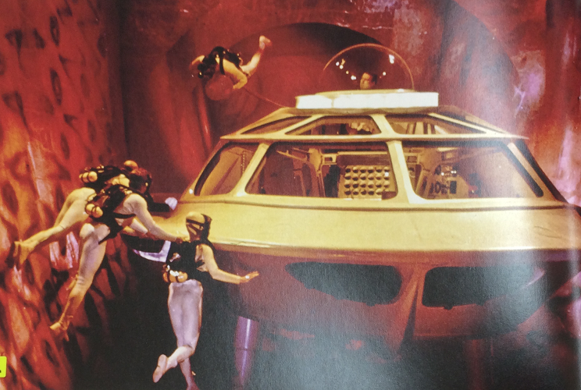
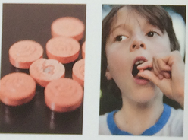
Fantastic Voyage (1966)
Ingestible human body sensors
Notes:
Silicon Valley’s Proteus Digital Health makes ingestible event markers (IEMs) that consist of a tiny integrated circuit and a thin-film battery, all encased in a coating similar to a vitamin’s. Once the marker is swallowed, the coating is dissolved by stomach fluids and the IEM is activated.
What makes the Proteus IEM different even from recent IEMSs is that it doesn’t use a radio signal, but actually sends a high-frequency electric current directly through the body’s conductive tissue. The signal can be picked up by a monitoring patch worn by the patient or implanted just under the skin, and then read by a wide range of platforms, including the patient’s smartphone or a physician’s computer.
Heart rate, respiration, body posture, even sleeping patterns.
The United States and the Soviet Union have both developed technology that can miniaturize matter by shrinking individual atoms, but only for a limited amount of time, depending on how small the item is miniaturized.
Scientist Jan Benes, working behind the Iron Curtain, has figured out how to make the process work indefinitely. With the help of the CIA, he escapes to the West, but an attempted assassination leaves himcomatose with a blood clot in his brain.
To save his life, agent Charles Grant (Stephen Boyd), pilot Captain Bill Owens (William Redfield), Dr. Michaels (Donald Pleasence), surgeon Dr. Peter Duval (Arthur Kennedy) and his assistant Cora Peterson (Raquel Welch) are placed aboard a specially designed submarine at the C.M.D.F. (Combined Miniaturized Deterrent Forces) facilities. The submarine, named the Proteus, is then miniaturized and injected into Benes. The ship is reduced to one micrometer, giving the team one hour to remove the clot. After 60 minutes the submarine will begin to revert to its normal size and become vulnerable to Benes' immune system.
The crew faces many obstacles during the mission. An arteriovenous fistula forces them to detour through the heart, where cardiac arrest must be induced to avoid turbulence, through the inner ear (all outside personnel have to remain silent to prevent turbulence) and replenish their supply of oxygen in the lungs. When the surgical laser needed to destroy the clot is damaged, it becomes obvious there is a saboteur on the mission. They cannibalize their radio to repair the device. When they finally reach the clot, there are only six minutes remaining to operate and then exit the body.
Before the mission, Grant was briefed that Duval was the prime suspect as a potential surgical assassin. But as the mission progresses, he pieces the evidence together and begins to suspect Michaels. During the critical phase of the operation, Dr. Michaels knocks Owens out and takes control of the Proteus while the rest of the crew is outside for the operation. Duval successfully removes the clot with the laser, but Michaels tries to crash the sub into the clot area to kill Benes. Grant fires the laser at the ship causing it to veer away and crash. Michaels is trapped in the wreckage and killed when white blood cells attack and destroy the Proteus. Grant saves Owens from the ship and they all swim desperately to one of the eyes where they escape via a teardrop seconds before they return to normal size.
In the original screenplay, there was a follow-up scene where we learn that, because of brain damage caused by the submarine, Benes no longer remembers the formula for unlimited miniaturization. Surviving stills suggest this scene was filmed but never used.

Slide 3

Contents
1
Information Retrieval
2
Clustering
3
Classification
4
Advanced
5
Summary

Slide 4
Distributed Grep
Find the document id and line number of a matching pattern
Map: (id, doc)→list(id, line #)
Reduce: None
grep “data mining” *
Documents Output
₁
₂
_{Map1}
<1, 123>
<3, 717>, <5, 1231>
<6, 1012>
₃
₄
₅
_{Map2}
₆
_{Map3}

Slide 5
URL Access Frequency
Map: (null, log)→(URL, 1)
Reduce: (URL, 1)→(URL, total_count)
Logs Map Output Reduce Output
_{Map1}
<u₁, 1>
<u₁, 1>
<u₂, 1>
<u₃, 1>
<u₃, 1>
<u₁, 2>
<u₂, 1>
<u₃, 2>
_{Map2}
_{Reduce}
_{Map3}

Slide 6
Inverted Index
Map: (id, doc)→list(word, id)
Reduce: (word, list(id))→(word, list(id))
Documents Map Output Reduce Output
_{Map1}
<w₁, 1>
<w₂, 2>
<w₃, 3>
<w₁, 5>
<w₁, [1, 5]>
<w₂, [2]>
<w₃, [3]>
_{Map2}
_{Reduce}
_{Map3}

Slide 7
Contents
1
Information Retrieval
2
Clustering
3
Classification
4
Advanced
5
Summary

Slide 8
Clustering Basics
Grouping data to form new categories (clusters)
Principle: maximizing intra-cluster similarity and minimizing inter-cluster similarity
e.g., customer locations in a city
two clusters

Slide 9
k-Means Clustering (1/3)
Arbitrarily choose k points from D as the initial cluster centers
(Re)assign each point to the cluster to which the point is the most similar, based on the mean value of the points in the cluster (centroid)
Update the cluster centroids, i.e., calculate the mean value of the points for each cluster
Repeat 2~3 until the criterion function converges

Slide 10
k-Means Clustering (2/3)
Notes:
K Means Clustering Example ))

Slide 11
k-Means Clustering (3/3)

Slide 12
k-Means on MapReduce (1/2)
[Chu et al., 2006]
Map: assigning each point to the closet centroid
Mapper1
Mapper2
Map (point p, the set of centroids):
for c in centroids do
if dist(p, c) < minDist then
minDist = dist(p, c)
closestCentroid = c
emit (closestCentroid, p)
Data Map Reduce
_{Split1}
_{Mapper1}
(1, …), (2, …)
_{Reducer1}
_{Split2}
_{Mapper2}
_{Reducer2}
(3, …), (4, …)

Slide 13
k-Means on MapReduce (2/2)
[Chu et al., 2006]
Reduce: updating each centroid with newly assigned points
Reducer1
Reducer2
Reduce (centroid c, the set of points):
for p in points do
coordinates += p
count += 1
emit (c, coordinates / count)
Repeat
Data Map Reduce
_{Split1}
_{Mapper1}
(1, …), (2, …)
_{Reducer1}
New centroids for C1 and C2
_{Split2}
_{Mapper2}
_{Reducer2}
New centroids for C3 and C4
(3, …), (4, …)

Slide 14
Thank You!
Any Questions?

